Slide 1
Synthesis of Classical-Nonclassical Hybrid Cannabinoids
Marcus A. Tius
University of Hawaii
CPDA Conference, Northeastern University
August 12, 2017

Slide 3
Approach to the Synthesis

Slide 4
One Way to Avoid Forming the abn Product
This works, but it adds steps and working with the cuprate
requires care to exclude air and moisture.

Slide 5
The Lilly Nabilone Synthesis

Slide 6
What is Wrong with the Lilly Nabilone Synthesis?

Slide 7
Improve by Getting Rid of Problematic Steps

Slide 8
Improve by Getting Rid of Problematic Steps

Slide 9
Something Does not Make Sense

Slide 10
Something Does not Make Sense

Slide 11
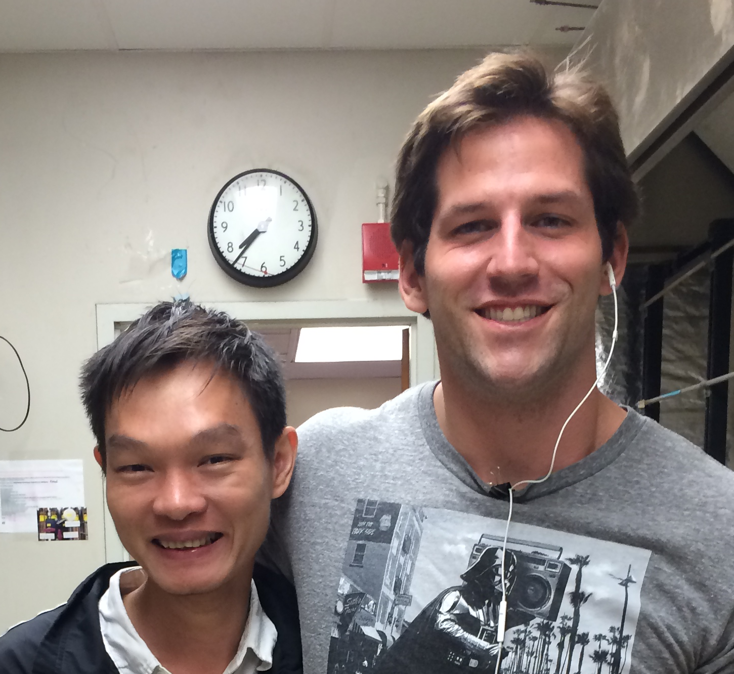
No Exotic Lewis Acid Needed!

Slide 12
C-11 Functionalized Hybrid Compounds

Slide 13
How to Modify the Lipophilic Sidechain

Slide 14
The Phenolic Hydroxyls can be Differentiated

Slide 15
The Phenolic Hydroxyls can be Differentiated

Slide 16
A Different Cross-Coupling Reaction

Slide 17
C1’-Aza Compounds and Salts

Slide 18
Introduction of the Lipophilic Group via Benzyne

Slide 19
Can the Same Approach be Used for the SAH?

Slide 20
Can the Same Approach be Used for the SAH?

Slide 21
Can the Same Approach be Used for the SAH?

Slide 22
There are Reasons to Want to Have a Handle on the SAH

Slide 23
Can the Same Approach be Used for the SAH?

Slide 24

Dr. Alex Makriyannis
The CPDA Conference Team
Financial support from NIH to A.M. (DA009158, DA023142, DA007215, and DA026795)
Group Members, past and present

Slide 25
Dr. Alex Makriyannis
The CPDA Conference Team
Financial support from NIH to A.M. (DA009158, DA023142, DA007215, and DA026795)
Group Members, past and present

