Slide 1
The DRUID® App for Measuring Impairment
Michael Milburn, Ph.D.
Psychology Department
UMass/Boston

Slide 2
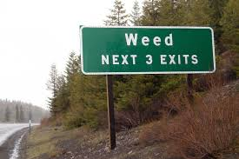
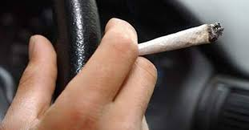
Statement of the Problem
Cannabis use is steadily increasing
throughout the United States
Cannabis consumption is
associated with dose-dependent
levels of cognitive impairment
However, there is no clearly defined standard for cannabis intoxication
Lack of a commonly accepted standard hinders federal, state and local efforts
to confront drugged driving

Slide 3
Statement of the Problem
Cannabis use is steadily increasing
throughout the United States
Cannabis consumption is
associated with dose-dependent
levels of cognitive impairment
However, there is no clearly defined standard for cannabis intoxication
Lack of a commonly accepted standard hinders federal, state and local efforts
to confront drugged driving

Slide 4
Statement of the Problem
Cannabis use is steadily increasing
throughout the United States
Cannabis consumption is
associated with dose-dependent
levels of cognitive impairment
However, there is no clearly defined standard for cannabis intoxication
Lack of a commonly accepted standard hinders federal, state and local efforts
to confront drugged driving

Slide 5
Statement of the Problem
Cannabis use is steadily increasing
throughout the United States
Cannabis consumption is
associated with dose-dependent
levels of cognitive impairment
However, there is no clearly defined standard for cannabis intoxication
Lack of a commonly accepted standard hinders federal, state and local efforts
to confront drugged driving

Slide 6
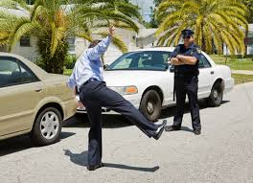
Current mechanisms to assess impairment
Currently, states must rely on observation; SFST; trained DRE officers; blood tests for THC level

Slide 7
Current mechanisms to assess impairment
However:
SFST does not reliably assess cannabis impairment
DRE training is expensive and subject to the criticism by defense attorneys that it is the officer’s subjective opinion
5 ng/mL of THC per se limit—not applicable if person has developed tolerance to THC through frequent use (courts have rejected this evidence)
Currently, states must rely on observation; SFST; trained DRE officers; blood tests for THC level

Slide 8
Law Enforcement Concerns
No way to assess driving under the influence of cannabis
No breath test equivalent for THC
Blood levels not predictive
NHTSA states, “It is difficult to establish a relationship between a person's THC blood or plasma concentration and performance impairing effects. Concentrations of parent drug and metabolite are very dependent on pattern of use as well as dose.” (NHTSA, 2016).

Slide 9
THC Impairs Driving
Reaction Time Slowed (Hunault et al., 2009; Lenne et al., 2010; Heustis, 2016 )
Coordination affected (Heustis, 2016)
Divided Attention Task performance affected (Anderson, et al., 2010)
→ All affect driving

Slide 10
Opioids and Impairment
By Dr. Chris Stewart-Patterson on November 25, 2014
The reported past-year use of opioid pain relievers by Canadians was 21% in 2010 [1]. Opioid medications may cause side effects of sedation, reduced attention, reduced short term memory, reduced reaction time, reduced coordination, blurred vision and miosis all of which can adversely affect driving capability.
A Canadian study notes that individuals on high doses of opioids (100-199 morphine equivalents) have an Odds Ratio of 1.42 for road trauma as compared with very low opioid doses [3].
Gomes, T. et al., (2013). Opioid dose and risk of road trauma in Canada: A population-based study. JAMA Internal Medicine, 173(3), 196-201. (View)

Slide 11
Alcohol and Impairment
.05% About 3 alcoholic drinks** | Exaggerated behavior May have loss of small-muscle control (e.g., focusing your eyes) Impaired judgment Usually good feeling Lowered alertness Release of inhibition | Reduced coordination Reduced ability to track moving objects Difficulty steering Reduced response to emergency driving situations
.08% About 4 alcoholic drinks** | Muscle coordination becomes poor (e.g., balance, speech, vision, reaction time, and hearing) Harder to detect danger Judgment, self-control, reasoning, and memory are impaired | Concentration Short-term memory loss Speed control Reduced information processing capability (e.g., signal detection, visual search) Impaired perception
https://www.cdc.gov/motorvehiclesafety/impaired_driving/impaired-drv_factsheet.html

Slide 12
Functional Impairment Equivalence
Slowing of reaction time
Difficulty with divided attention tasks
Cerebellum affected (balance, coordination, etc.)

Slide 13
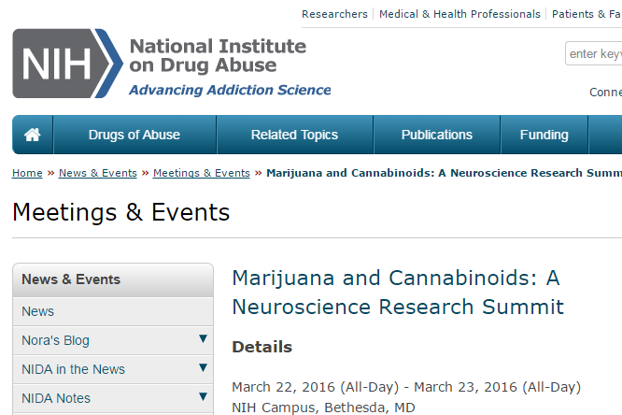

Slide 14
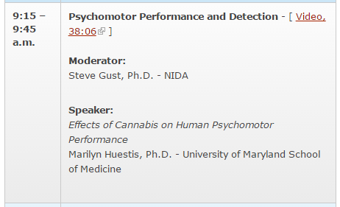

Slide 17
“DRiving Under the Influence of Drugs”
www.druidapp.com

Slide 18
How DRUID® Works
Driving Impairment Literature
Four Tasks, measuring:
Reaction Time
Decision Making
Object Tracking--Hand/Eye
Coordination
Time Estimation
Balance
Divided Attention Tasks (DATs)
Takes 2 minutes to complete
Available for iPads, iPhones; Android version in a week or two
Calculates DRUID® Total Impairment Score

Slide 19
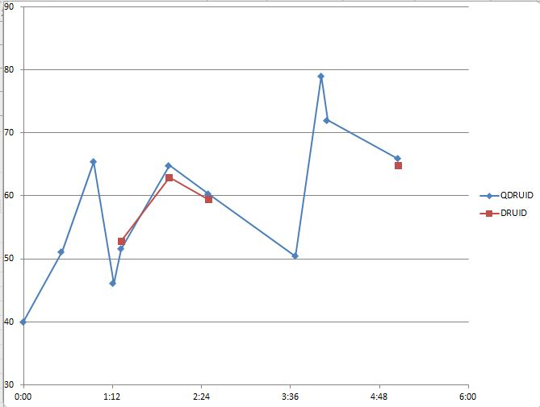
Calibration

Slide 20
Calibration
Cannabis self-administration

Slide 21
DRUID® Reliability Assessing Cannabis Impairment
DRUID® Impairment Scores from same participant, vaporizing two samples (.4 gm) from the same batch of marijuana on two successive days

Slide 22
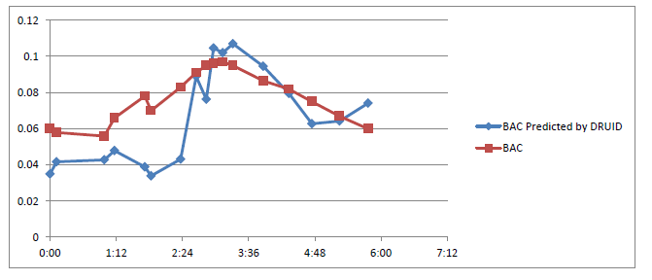
DRUID® scores and Blood Alcohol Concentration
r = .86
Estimated BAC
BAC
TIME
DRUID® and BacTrak Breathalyzer done repeatedly in close succession over a three hour period

Slide 23
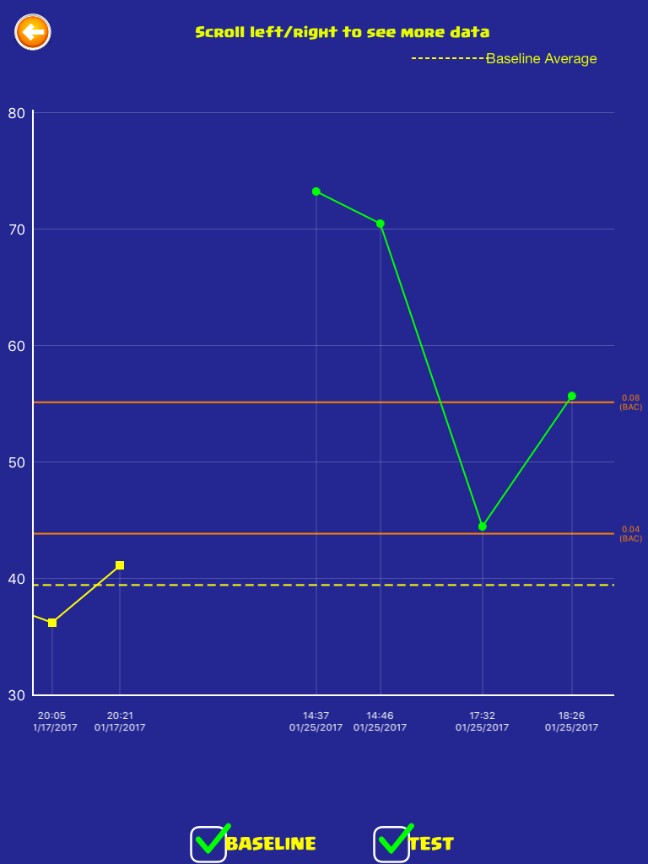
DRUID® includes graphic display of results, showing impairment level (in green),
and estimated BAC equivalent (in red)
BAC = .08
BAC = .04

Slide 24
DRUID® includes graphic display of results, showing impairment level (in green),
and estimated BAC equivalent (in red)
BAC = .08
BAC = .04

Slide 25
DRUID® includes graphic display of results, showing impairment level (in green),
and estimated BAC equivalent (in red)
BAC = .08
BAC = .04

Slide 26
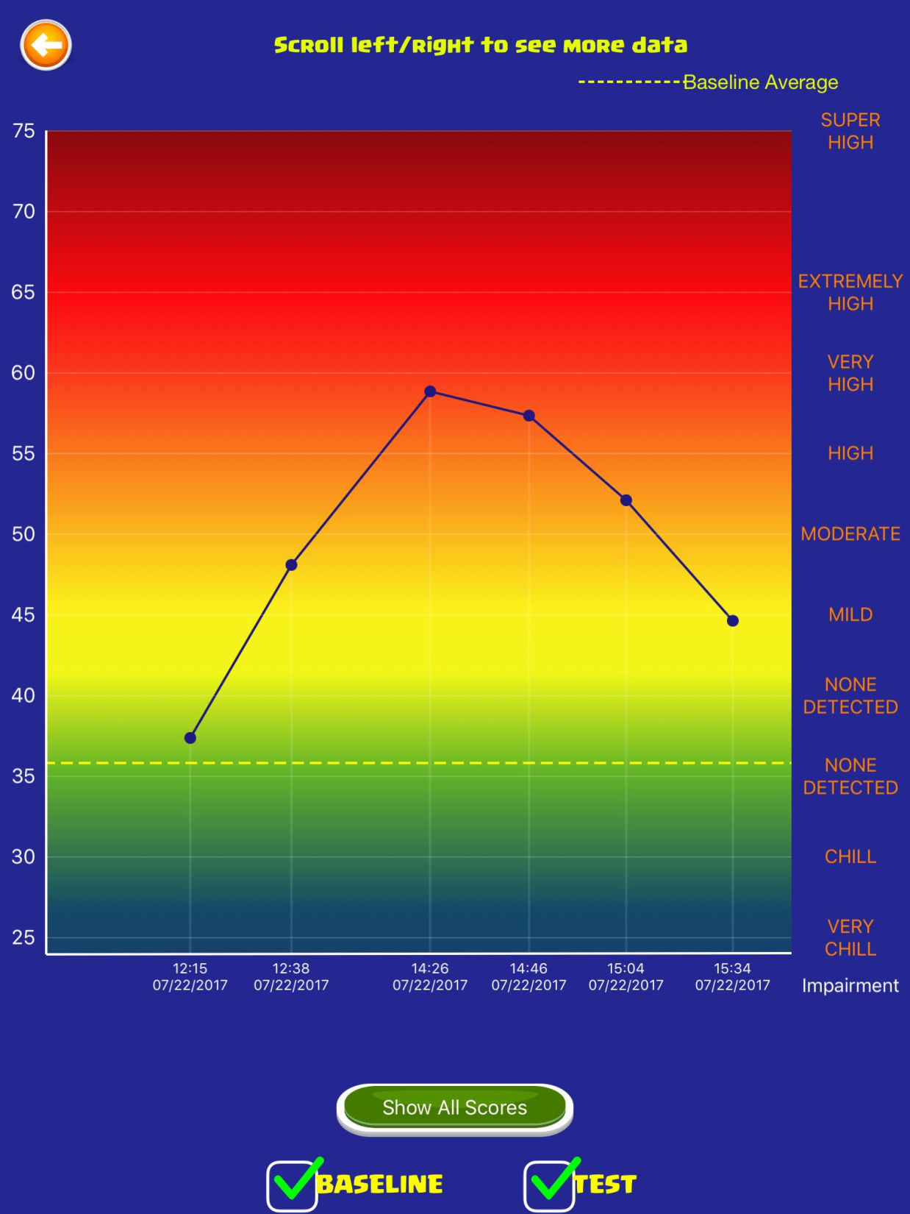
New Results Display Graph

Slide 27
TASK 1

Slide 28
TASK 1

Slide 29
TASK 1

Slide 30
TASK 2

Slide 31
TASK 2

Slide 32
TASK 3

Slide 33
TASK 3

Slide 34
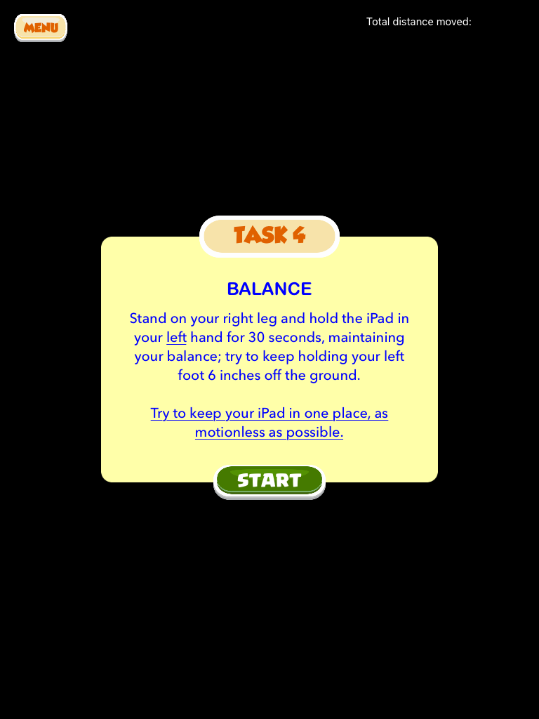
TASK 4

Slide 35
DRUID Demo
https://www.druidapp.com/howtouse

Slide 36
Early Prototype of DRUID
One of our test subjects using DRUID

Slide 37
Test Results

Slide 38
Massachusetts Regional Municipal Police Academy—Randolph—July 2017
Collaboration with Dr. Jack Richman, MCPHS, DRE
Spent 4 days collecting data
MA is one of 15 states that trains cadets in the SFST—most other states show videos
Volunteers recruited to drink alcohol to a BAC > .08—then stopped drinking
Used DRUID® every time collected BAC data

Slide 39
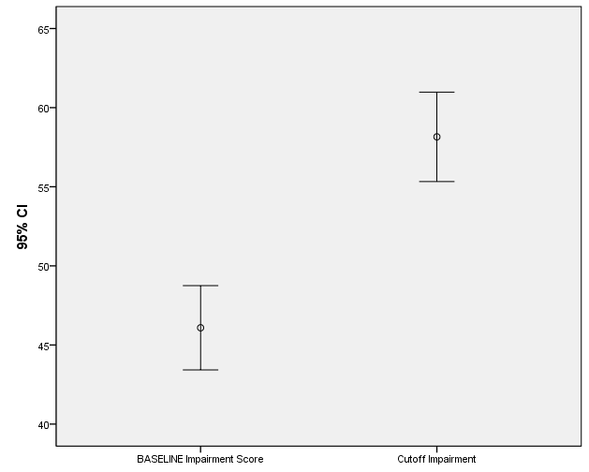
DRUID® Alcohol Impairment Results Massachusetts Regional Municipal Police Academy--Randolph
Baseline DRUID score vs. DRUID score when BAC > .08 cutoff
t ₍₁₉₎ = 8.2, p < .001; partial eta-squared = .78

Slide 40
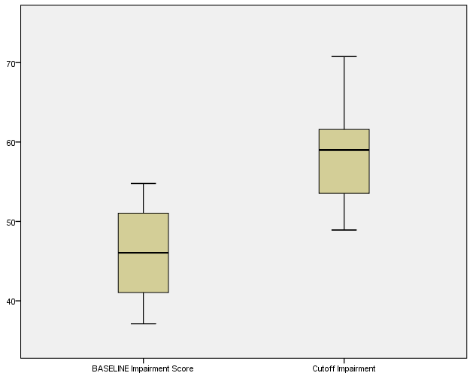
Box Plots of unimpaired DRUID scores versus cutoff impairment level DRUID scores

Slide 41
DRUID® Database Results for Cannabis Impairment
Assessing cannabis impairment
Over 1500 individual uses of DRUID® saved to Database
Selected all individuals who completed at least two baselines scores and reported impaired on “Marijuana”
Compared baseline DRUID® average to DRUID® impairment score from cannabis

Slide 42
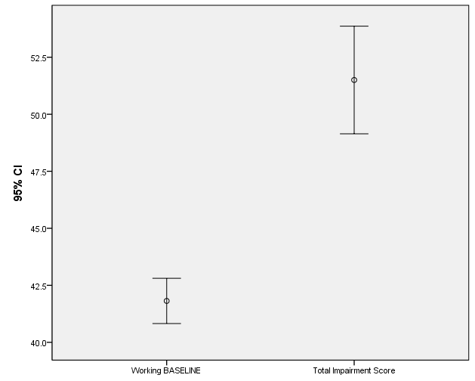
DRUID® Database Results for Cannabis Impairment
Baseline DRUID score vs. “Marijuana”-impaired DRUID score
t ₍₈₉₎ = 7.4,
p < .001; partial eta squared = .38

Slide 43
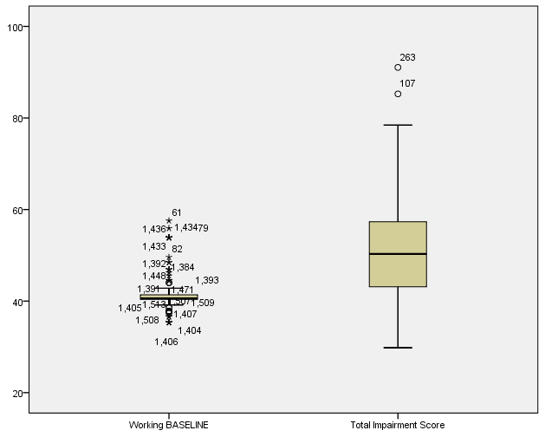

Slide 45
Research Currently Underway Using DRUID®
Washington State University—Brian Clowers (chemistry)
UC Boulder—Cinnamon Bidwell (Psychology and Neuroscience)
Brown University—Jane Metrik (School of Public Health)

Slide 46
Planned Research Studies
Medical Cannabis Patients
Do they develop tolerance?
Are they characterized by a chronic higher level of impairment?
Facebook group of MMJ patients

Slide 47
Collaborations Under Development
Johns Hopkins—Ryan Vandray
Univ. of Iowa—Robert Philibert
Additional cannabis breathalyzer developers in Texas and Massachusetts

Slide 48
In Conclusion DRUID®
Provides a tool to assess impairment from a variety of sources
Has application in research, law enforcement and industrial settings, possibly concussion testing; doctors prescribing medications

Slide 49
Thanks

Slide 50
Marilyn Huestis (2016)
THC disrupts functioning of the cerebellum and basal ganglia, brain areas that regulate balance, posture, coordination, and reaction time
Marijuana significantly impairs judgment, motor coordination, and reaction time, and studies have found a direct relationship between blood THC concentration and impaired driving ability

